Slide 1

Shark Attacks: A Capitalist approach

Slide 2
Agenda
The Challenge
Data Set
Goals for the analysis
Cleaning and Manipulation Methods
The Results
Future Improvements

Slide 3

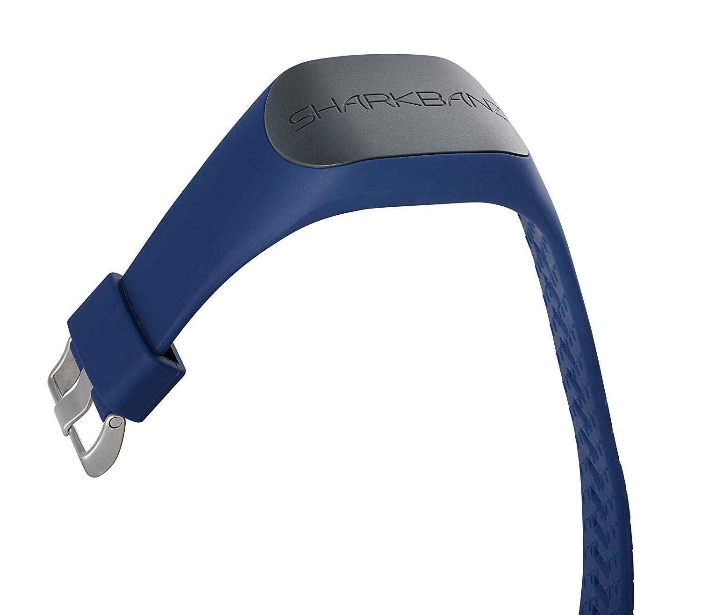
The Challenge

Slide 4

Dataset
Shark Attack incidents
This is a table of shark attack incidents compiled by the Global Shark Attack File until 2016. http://www.sharkattackfile.net/index.htm (5992, 24)

Slide 5
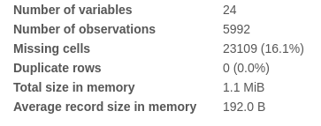
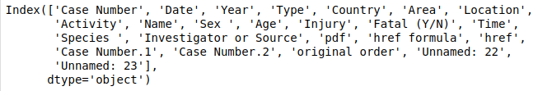
Dataset
Data Info
Columns

Slide 6
Goals for the analysis
Track areas with higher risk
Dropping useless data for commercial purpose.
Show as clear as possible the results

Slide 7
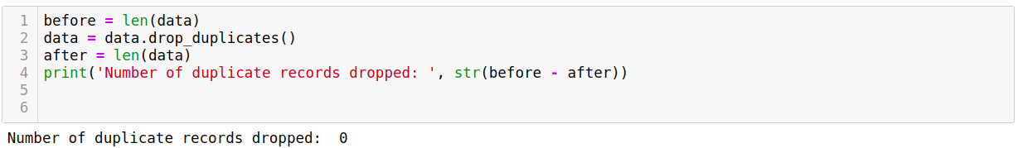
Cleaning and Manipulation
Identify and fill in missing values
Identify and remove duplicate records

Slide 8
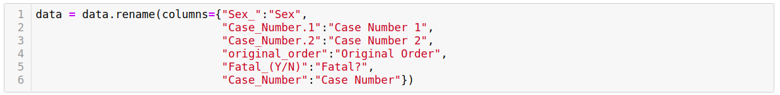
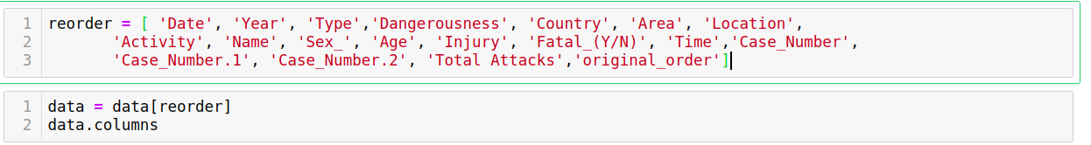
Cleaning and Manipulation
Rename columns in a data frame
Change the order of the columns

Slide 9
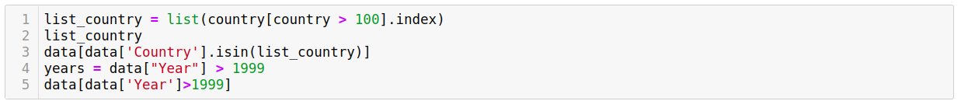
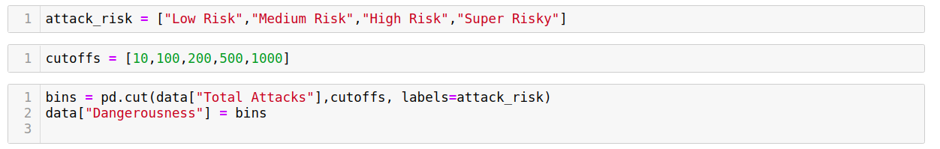
Cleaning and Manipulation
Filter records based on conditional statements
Labels and cut offs

Slide 10
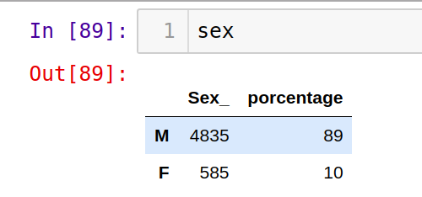
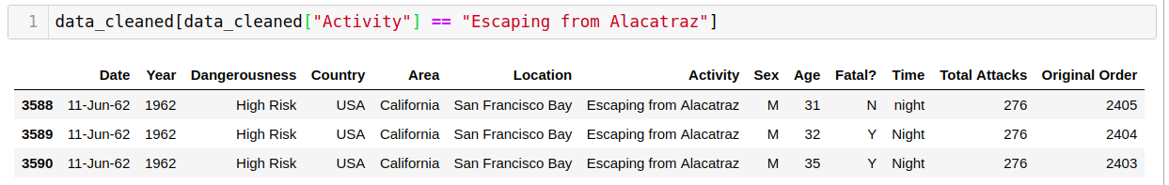
89%
Of the victims are male
3
are super unlucky

Slide 11


The Results

Slide 12
Future improvements
Add label for the time
Normalize age columns
Drilldown to check specific locations

Slide 13
Esta es la idea más importante con la que se debe quedar todo el mundo.
Obrigado!

